Slide 1


MIT School of Computing
Third Year Engineering
Full Stack Frontend Development
Student Name: Isha Yadav
Enrollment Number: ADT23SOCB1632
Project Title: Event Management
Guide/Supervisor: Prof. Rohini Bhosale
Institution/Department: MIT ADT University — School of Computer Engineering & Technology
Date: 07-11-2025

Slide 2
MIT School of Computing
Introduction:
EventHub is a modern and user-friendly Event Management Website developed using React.js. It allows users to browse events, register/login, add events to cart, and proceed with booking. The system focuses on fast UI rendering, real-time updates, and smooth user experience.
Problem Statement:
Traditional event booking systems require physical visits or manual registrations, causing time delays and limited accessibility. Users lack a central place to explore multiple events and manage bookings online.
Motivation:
To simplify event discovery and booking, especially for students and professionals organizing university or corporate events.
Proposed Solution:
Develop a scalable, component-based event management platform using React.js that supports authentication, event browsing, and seamless cart-based booking.

Slide 3
MIT School of Computing
Scope and Objectives
Project Scope:
✔ User login & registration module
✔ Display list of available events with images & pricing
✔ Add to cart and remove from cart functionalities
✘ Payment integration (future enhancement)
✘ Admin panel (out of scope for current version)
Key Objectives:
Implement a functional user authentication system
Develop a responsive and interactive React UI
Manage user cart and event booking flow
Maintain modular coding using reusable components

Slide 4
MIT School of Computing
Technology Stack
Category | Technologies Used
Front-End | React.js, HTML5, CSS3, JavaScript, Tailwind CSS
Database | (optional), LocalStorage for this version
Other Tools | Git, GitHub, npm, VS Code.

Slide 5
MIT School of Computing
Database Design
ER Diagram Entities:
User (userId, name, email, password)
Event (eventId, eventName, price, date, location)
Cart (cartId, userId, eventId)
Relationships:
One User → Many Cart Items
One Event → Many Cart Entries

Slide 6
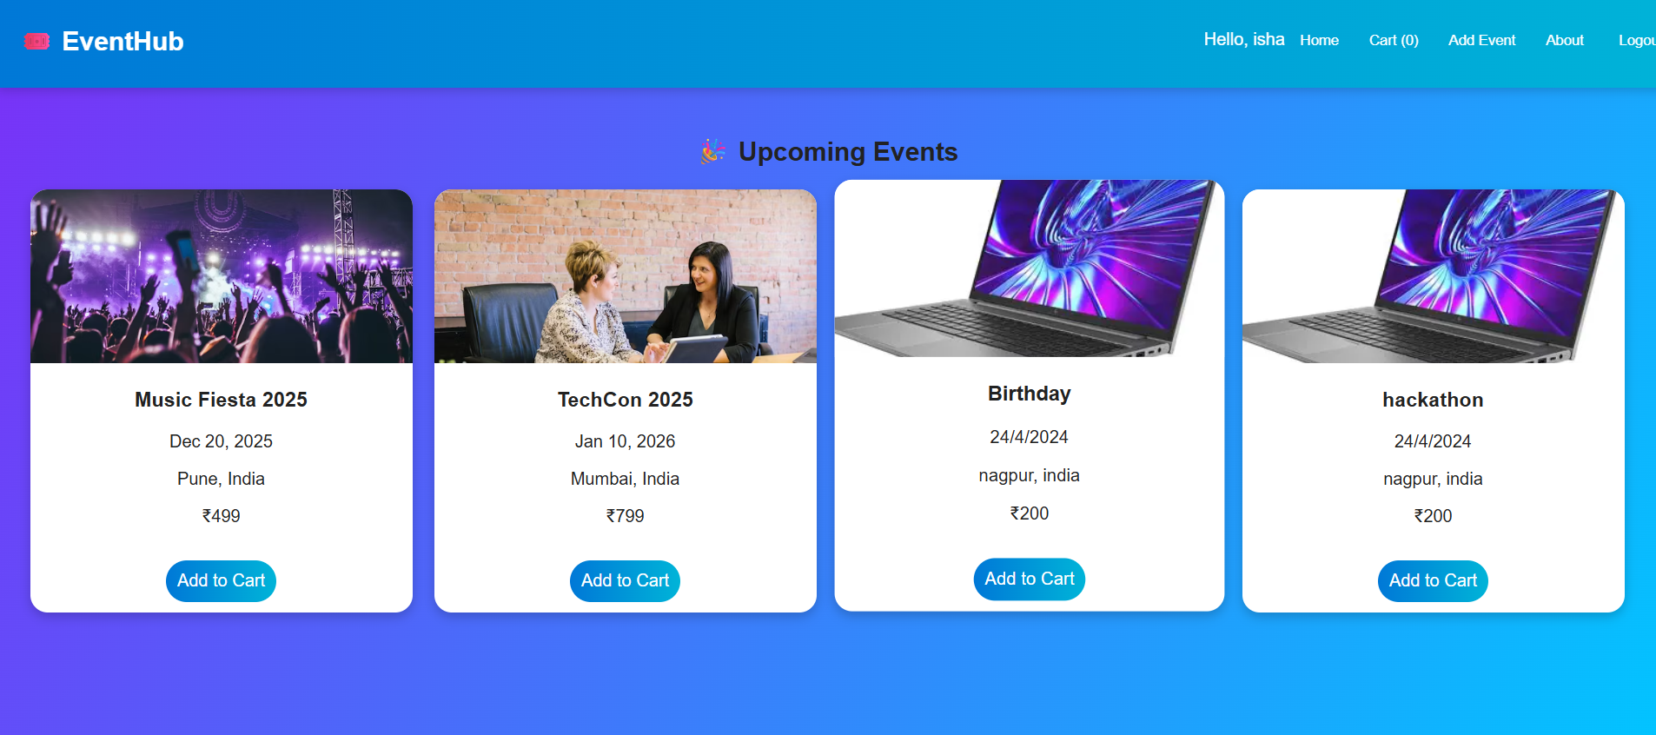
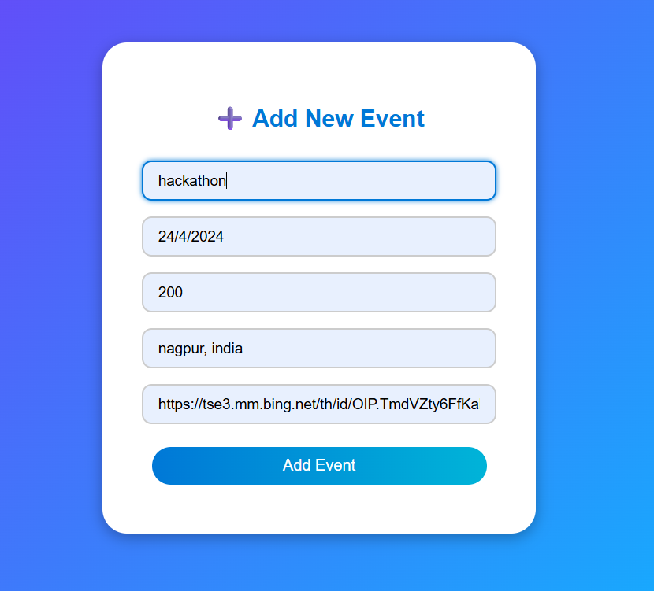
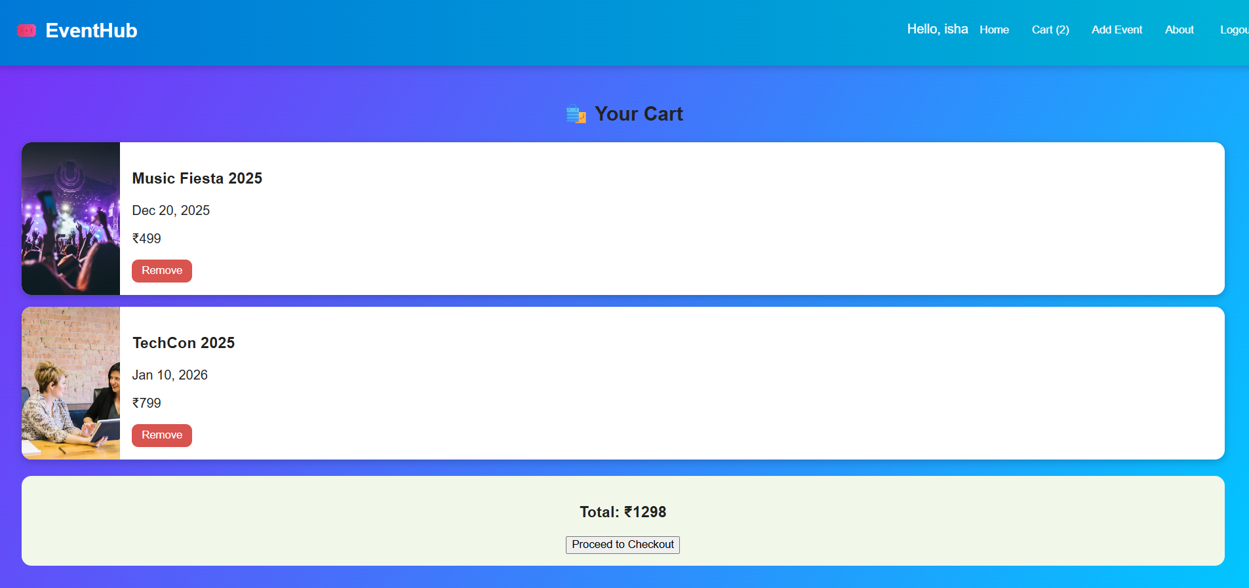
MIT School of Computing
Implementation & Results (Front-end)

Slide 7
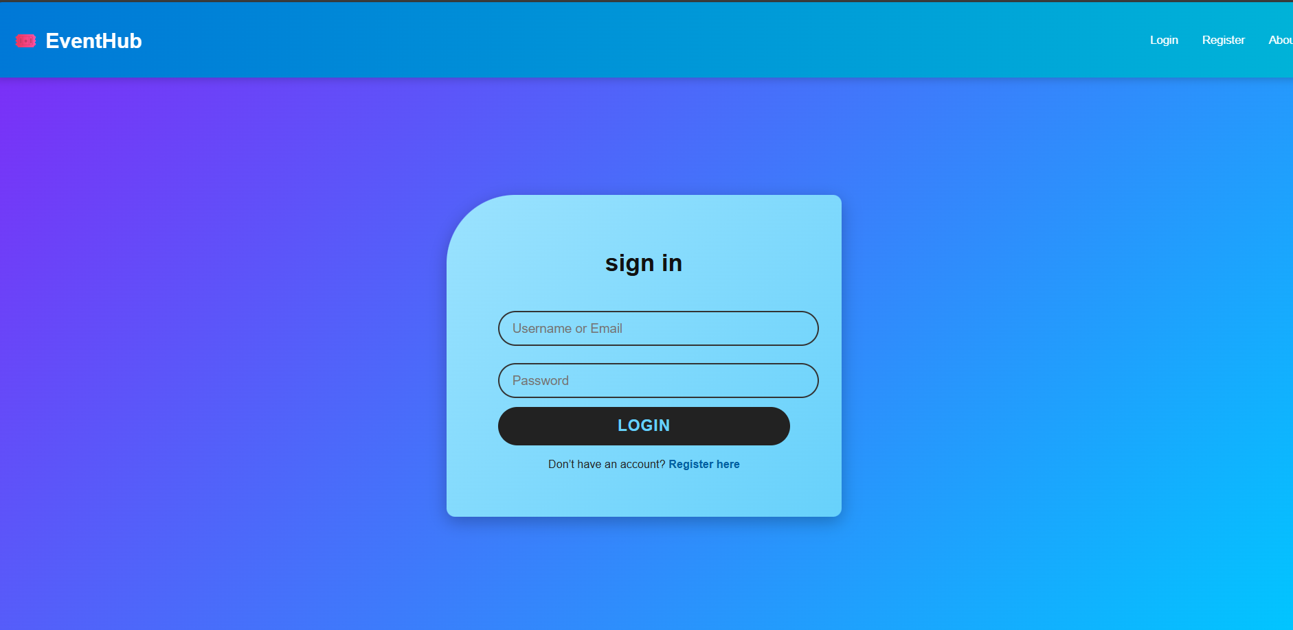
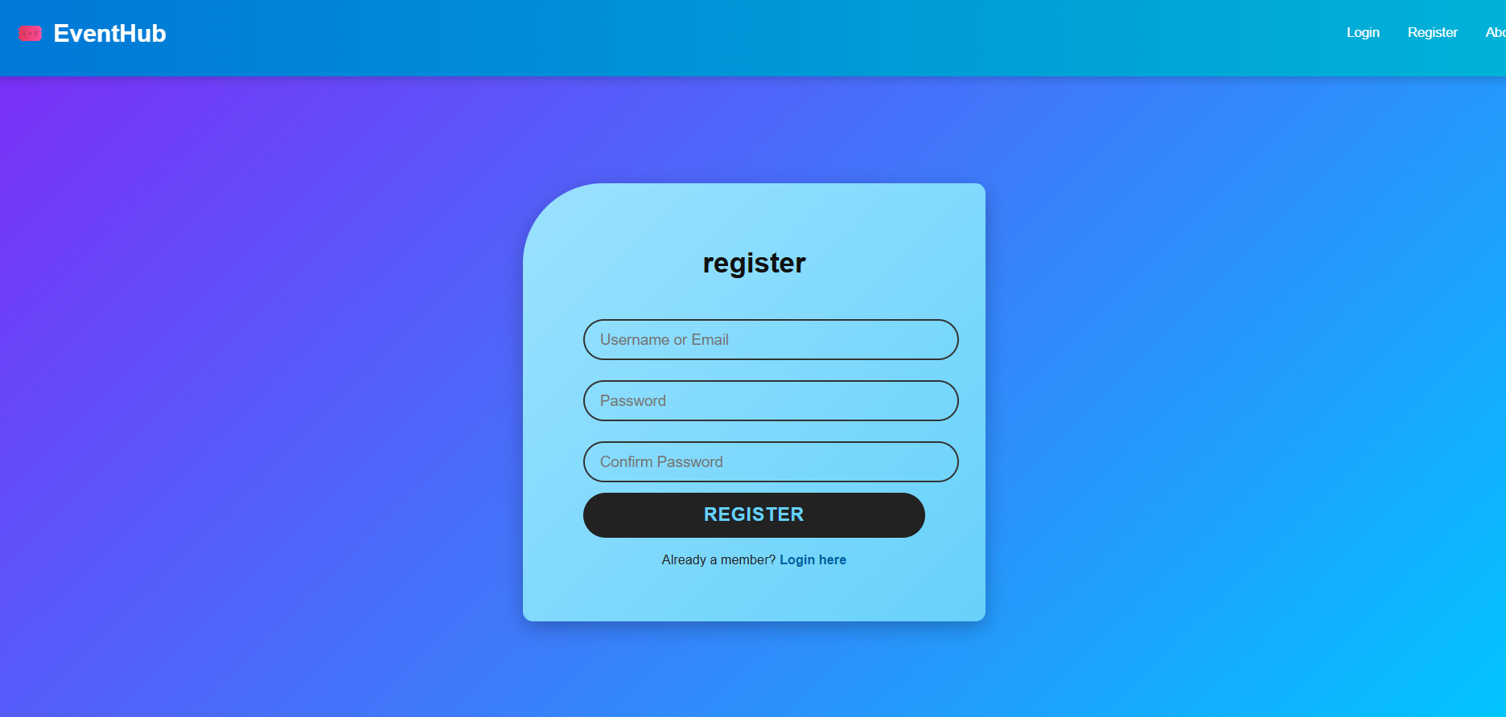
MIT School of Computing
Demo

Slide 8
MIT School of Computing
Challenges and Solutions
Challenge | Solution
React state management complexity | Used React Hooks (useState, useEffect)
Navigation between pages | Used conditional rendering / React Router
LocalStorage persistence | Implemented logic to store user session data

Slide 9
MIT School of Computing
Conclusion and Future Scope
Conclusion:
Successfully built a functional and responsive Event Management Website.
Learned React components, state management, and UI handling.
Future Enhancements:
Admin dashboard
Payment Gateway (Razorpay / Stripe)
Event analytics and ticket generation

Slide 10
MIT School of Computing
THANK YOU

